Slide 1
Modeling the Anharmonic Oscillator
Adrian Martin
Computational Physics
March 9, 2018

Slide 2
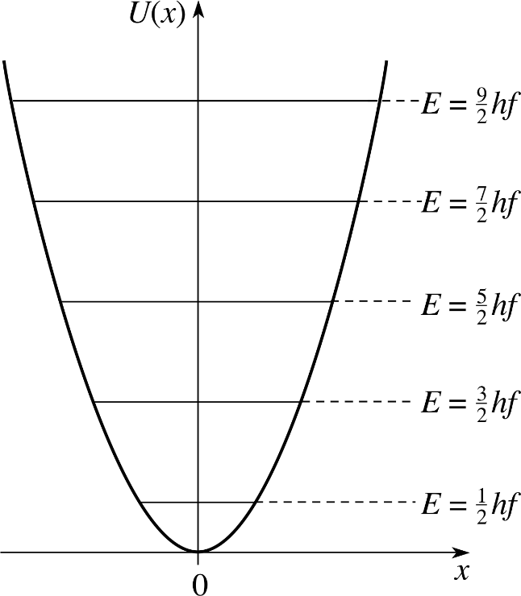
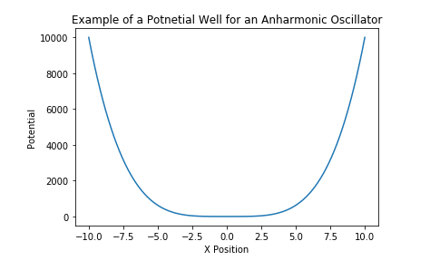
Anharmonic vs Harmonic Oscillators
Harmonic oscillators have potential function V(x) = x²
Period does not vary based on amplitude
Some systems are approximately harmonic under certain conditions
Anharmonic oscillators can have any potential function besides V(x) = x² e.g. V(x) = x⁴
Period depends on amplitude
Most natural systems are anharmonic

Slide 3

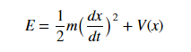
Modeling Period vs Amplitude
Equation that relates period and amplitude:
Used Romberg integration in code
Derived from:

Slide 4
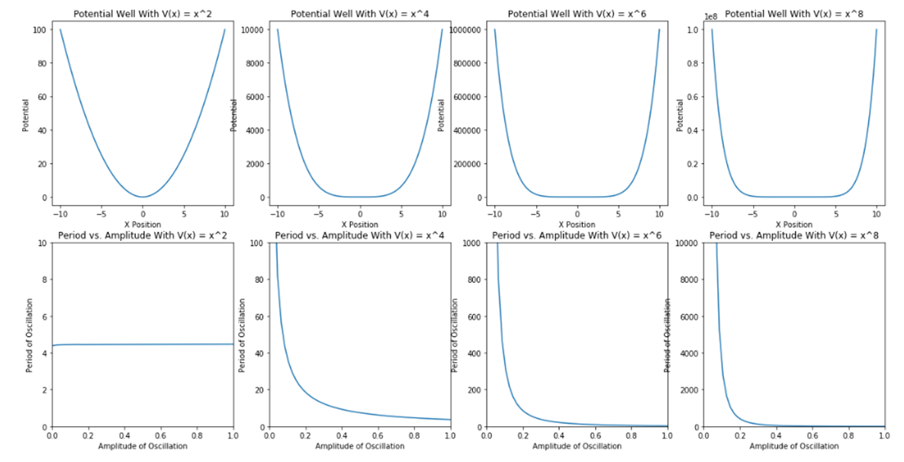
Oscillators with potential functions V(x) = x^{n}

Slide 5
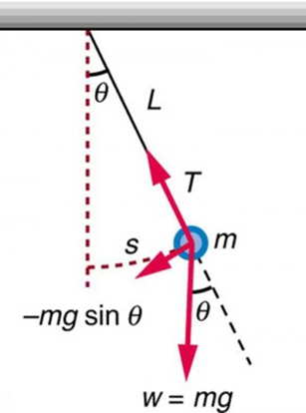

The Pendulum
A pendulum swinging at large amplitudes is an example of an anharmonic oscillator
Boundary conditions:
https://www.youtube.com/watch?v=U30vnuplsnU

Slide 6
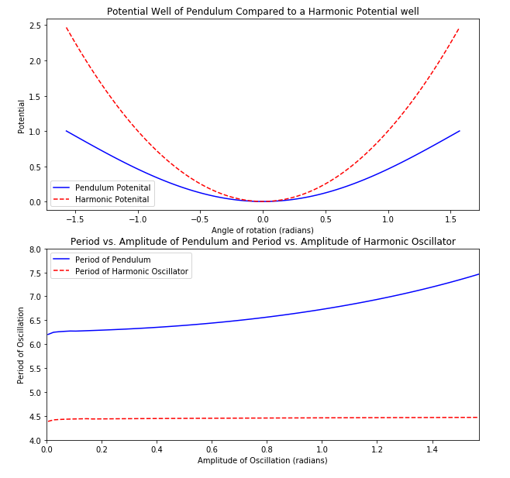
Modeling Pendulum Motion
Pendulum potential function:
V(x) = 1 – cos(x)
Harmonic Potential Function:
V(x) = x²
By the small angle approximation,
cos(x) ≈ 1 + x² at small angles

Slide 7
Sources
[1] Amore, P., Cervantes Valdovinos, M., Ornelas, G., & Zamudio Barajas, S. (2007). The nonlinear pendulum: formulas for the large amplitude period. Revista mexicana de física E, 53(1), 106-111.

